Slide 1

1 | 2
Lesson 1b - Extension Activity: You Live on Turtle Island
Objective: Students will be able to identify and interpret images and themes from art and literature, in order to tell the meaning of climate justice in their own words.

Slide 2
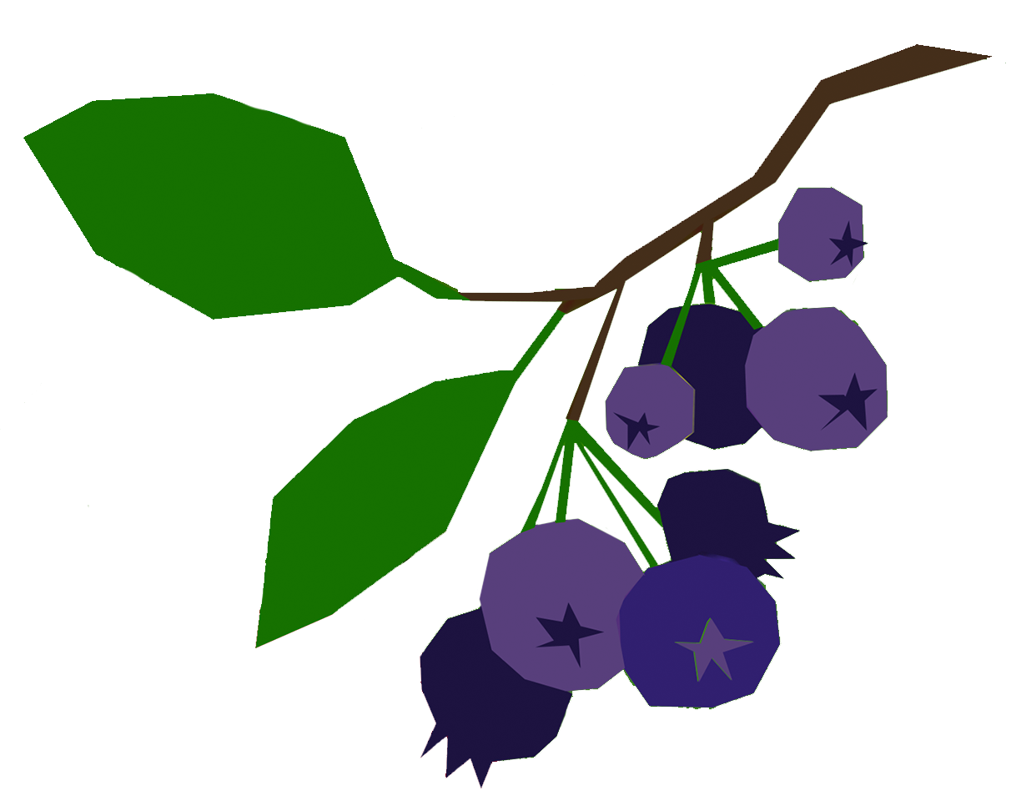
 | 2
Key Terms
Character: A person, animal, or object that plays a role in a story
Character
Skit: A short play
Skit
Dialogue: Conversation
Dialogue

Slide 3
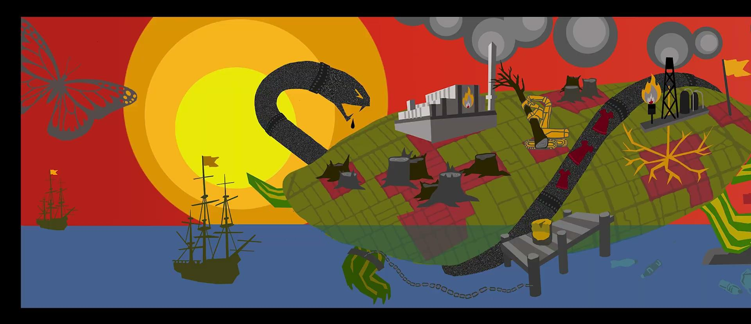
 |  | 6 | 8 | 20
LOOK
Look at the character list. Can you find all of these characters in the mural? Are there any characters missing from the list?

Slide 4
 |  | 6 | 8 | 20
PAIR
You will be assigned a partner and two characters from the mural. With your partner, you will:
Draw both of your characters on side 1 of your worksheet
On page 2 of your worksheet, write a dialogue between your two characters (without mentioning either character by name)
Write at least 1 sentence that each character would say to the audience (without mentioning their name)
Practice your skit together
If you have extra time, choose one or more of the following:
Add more dialogue between your characters
Create costumes, props, or gestures to use in your skit
Draw a new image showing both of your characters interacting with each other

Slide 5
 |  | 6 | 8 | 20
PRACTICE
Complete both sides of the worksheet. Then, practice your skit!

Slide 6
 |  | 6 | 8 | 20 | 45
GUESS
Watch and listen while your classmates perform their skits. Then, raise your hand to guess their characters!

Slide 7


End of Lesson 1b - Extension Activity: Thank You!

