Slide 1

1 | 3
Lesson 2: Climate Justice in Lenapehoking
Objective: Working in groups, students analyze one panel of a climate justice infographic, in order to share local examples of humans changing the environment for better and for worse.

Slide 2

 | 3
Key Terms
Infographic: a visual display that makes information easy to understand by using colors, sizes, shapes, numbers, words, charts, graphs, and images
Infographic
Analyze: to study something carefully and in depth
Analyze
Climate Justice: by the end of this unit, you should be able to define this term in your own words!
Climate Justice
Note: Each infographic panel also has its own vocabulary words and definitions.

Slide 3



 |  | 6 | 8
Raise your hand to answer:
What does it mean to analyze something?
Can you give an example of a time when you analyzed something?
What is the point of analyzing something?

Slide 4
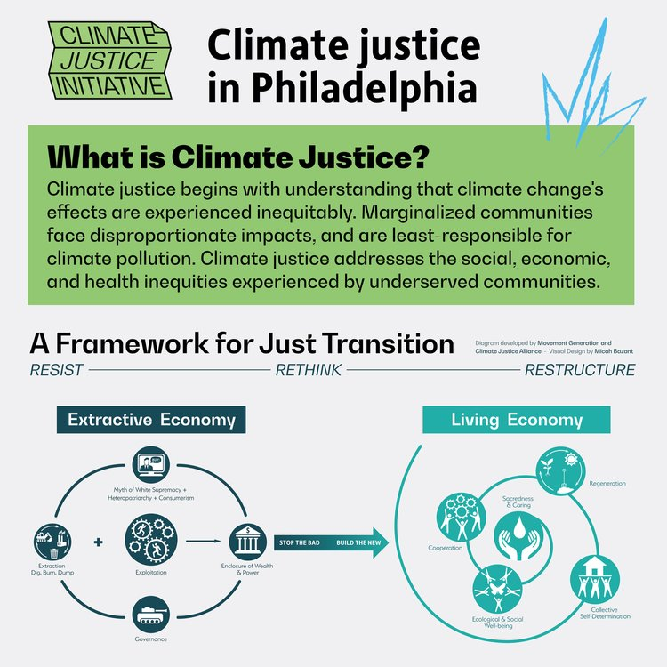
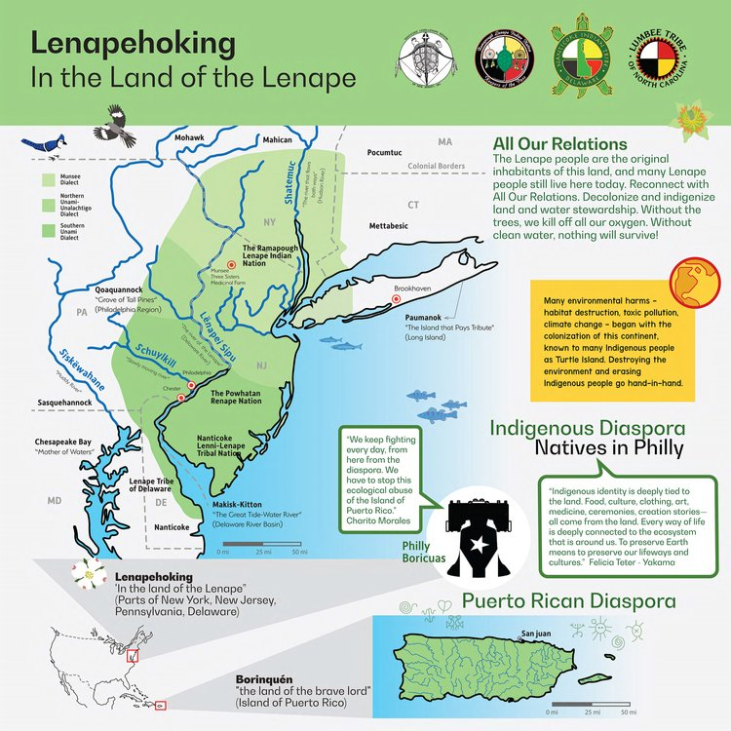
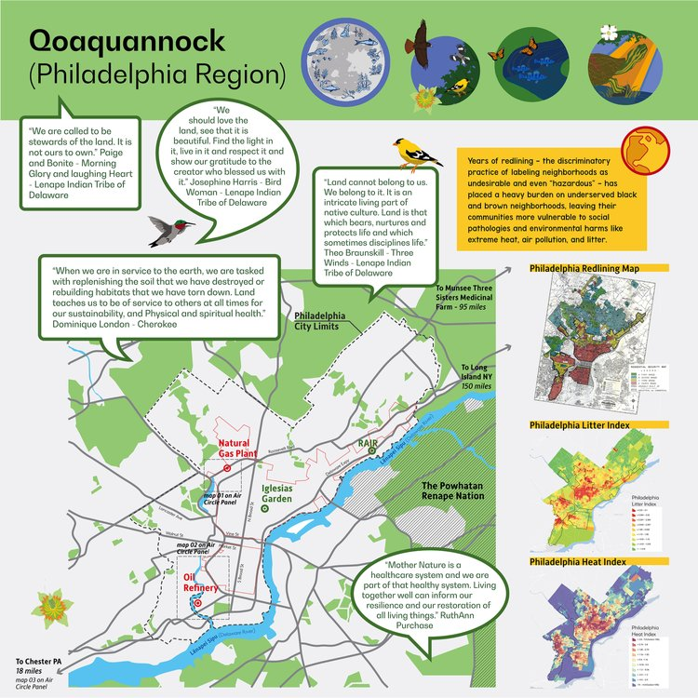
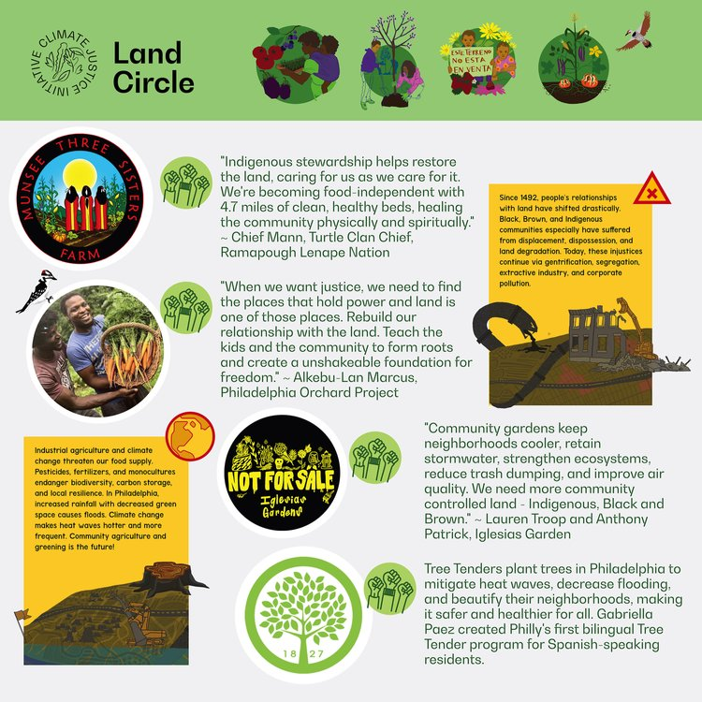
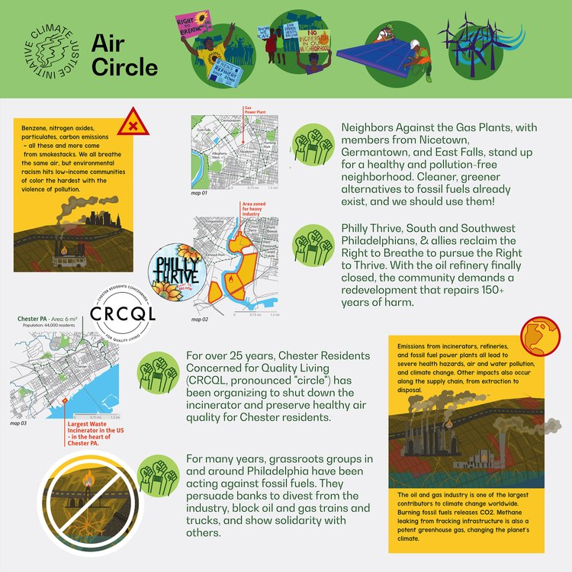
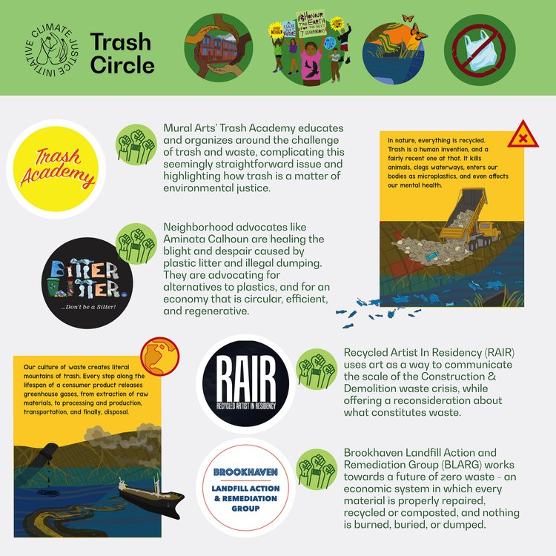
 |  |  | 8
Each group will analyze one of these six infographic panels
Together with your group, fill out the Infographic Presentation Organizer handout
Then, present your infographic panel to the rest of the class

Slide 5
 |  |  |  | 32
Group work time
Group 1
Name 1 | Name 2
Name 3 | Name 4
Name 5 | Name 6
Group 2
Name 1 | Name 2
Name 3 | Name 4
Name 5 | Name 6
Group 3
Name 1 | Name 2
Name 3 | Name 4
Name 5 | Name 6
Group 4
Name 1 | Name 2
Name 3 | Name 4
Name 5 | Name 6
Group 5
Name 1 | Name 2
Name 3 | Name 4
Name 5 | Name 6
Group 6
Name 1 | Name 2
Name 3 | Name 4
Name 5 | Name 6

Slide 6
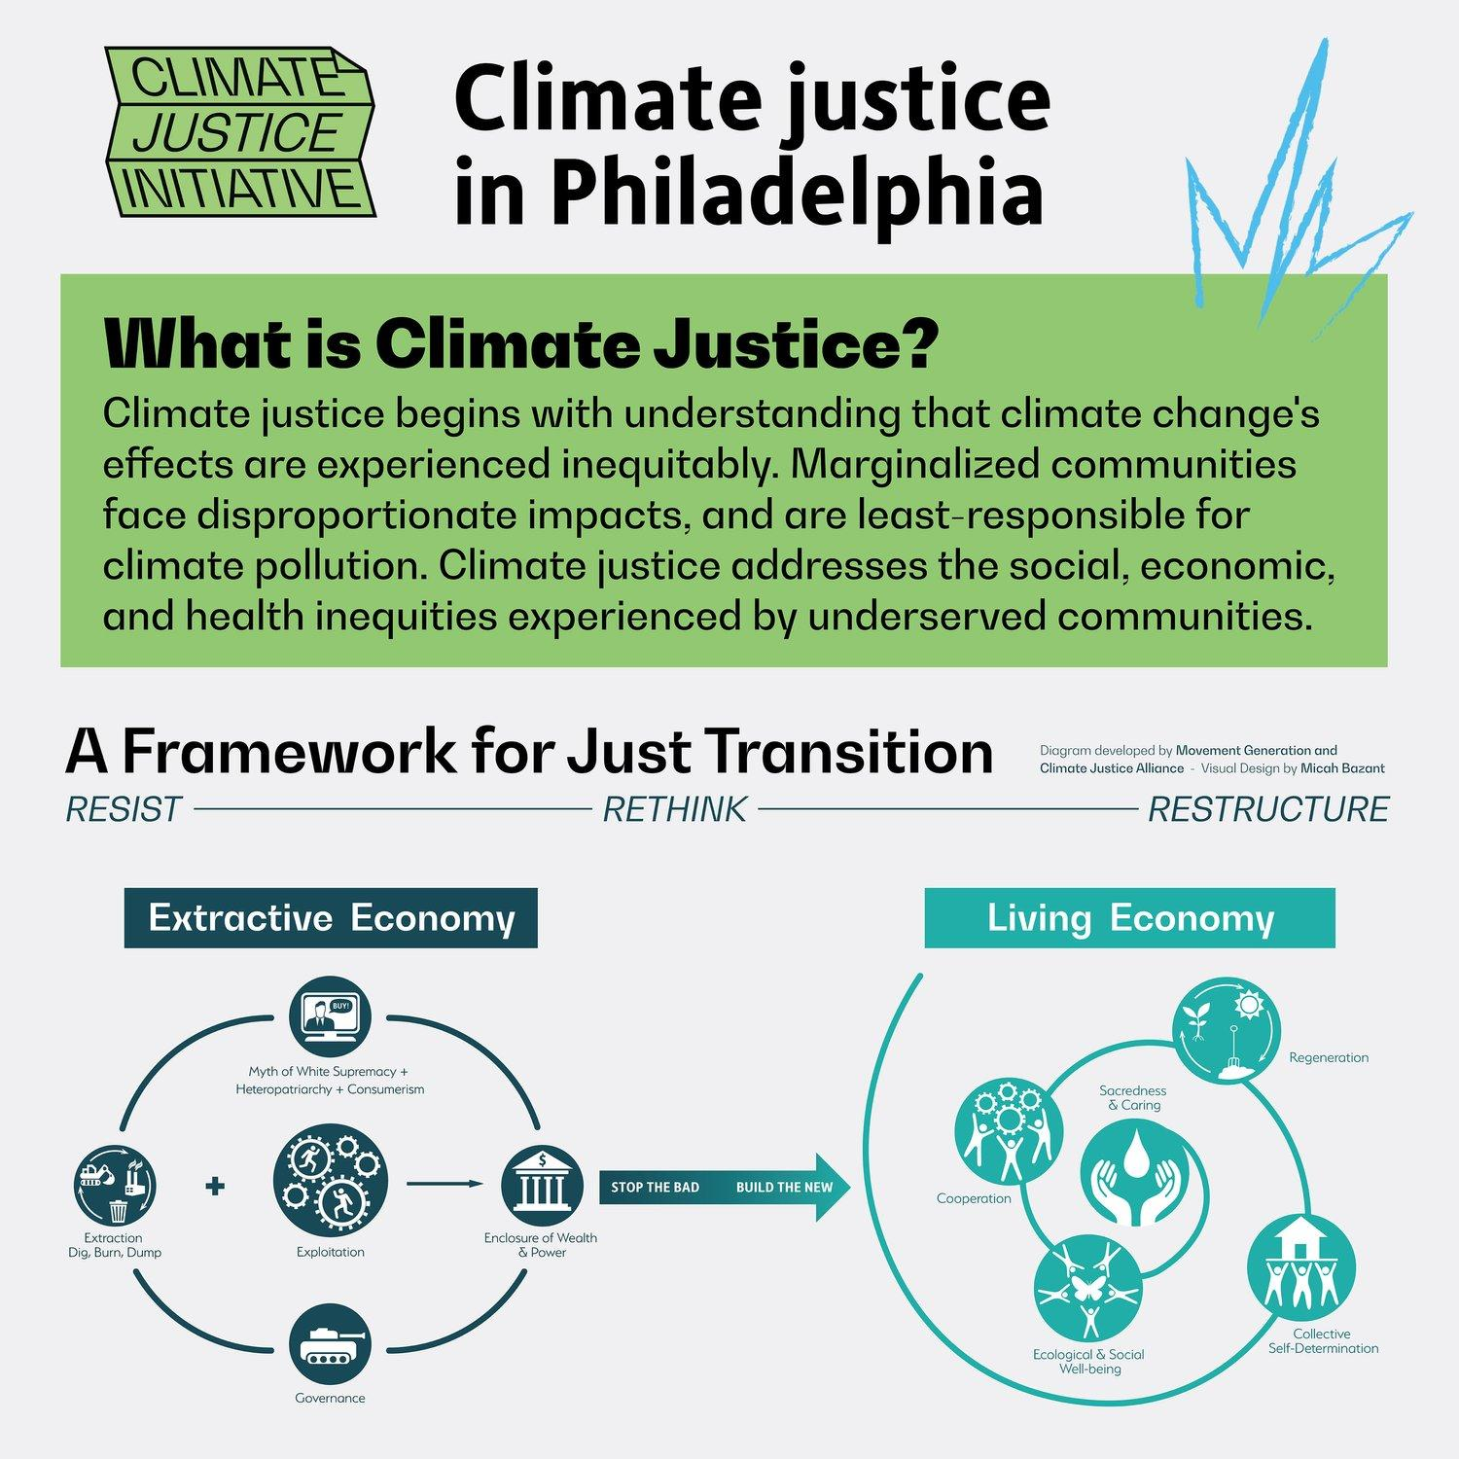
 |  |  |  |  | 34 | 36 | 38 | 40 | 42 | 45
SHARE
Main idea
Author’s purpose or point of view
One problem or issue
What are people and communities doing to help solve the problem?
3 key words or phrases
3 key pictures or images
What we still wonder

Slide 7
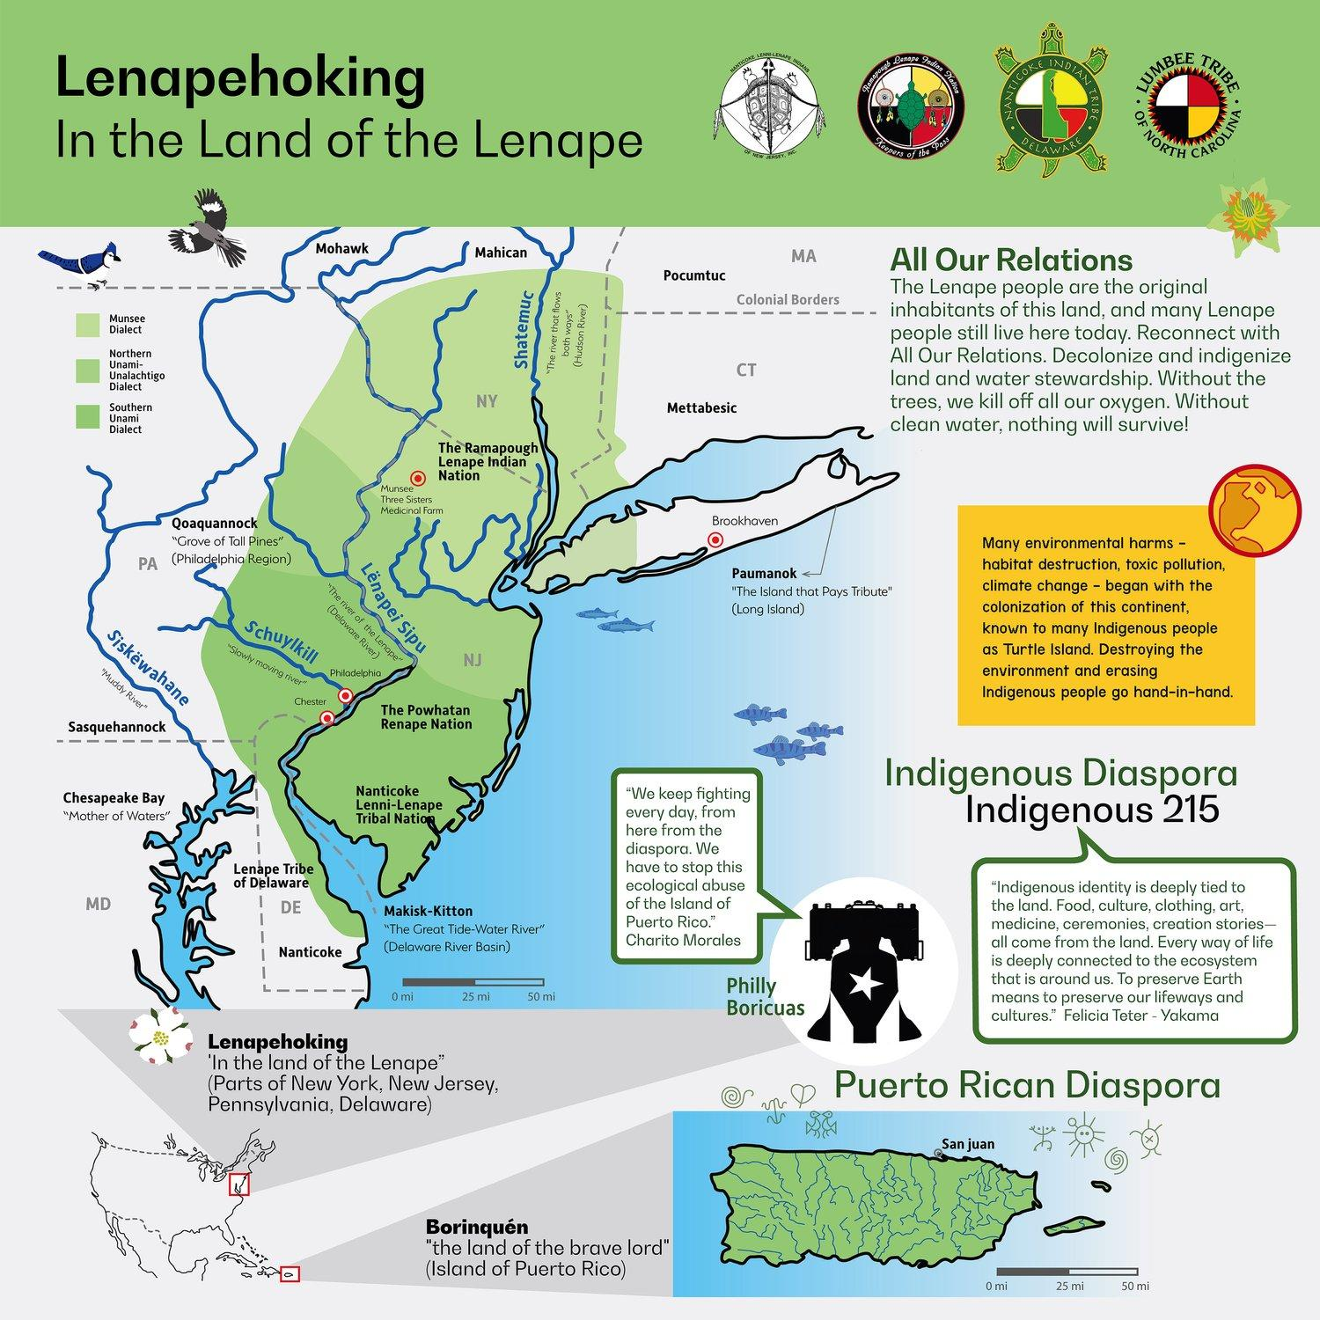
 |  |  |  |  |  | 36 | 38 | 40 | 42 | 45
SHARE
Main idea
Author’s purpose or point of view
One problem or issue
What are people and communities doing to help solve the problem?
3 key words or phrases
3 key pictures or images
What we still wonder

Slide 8
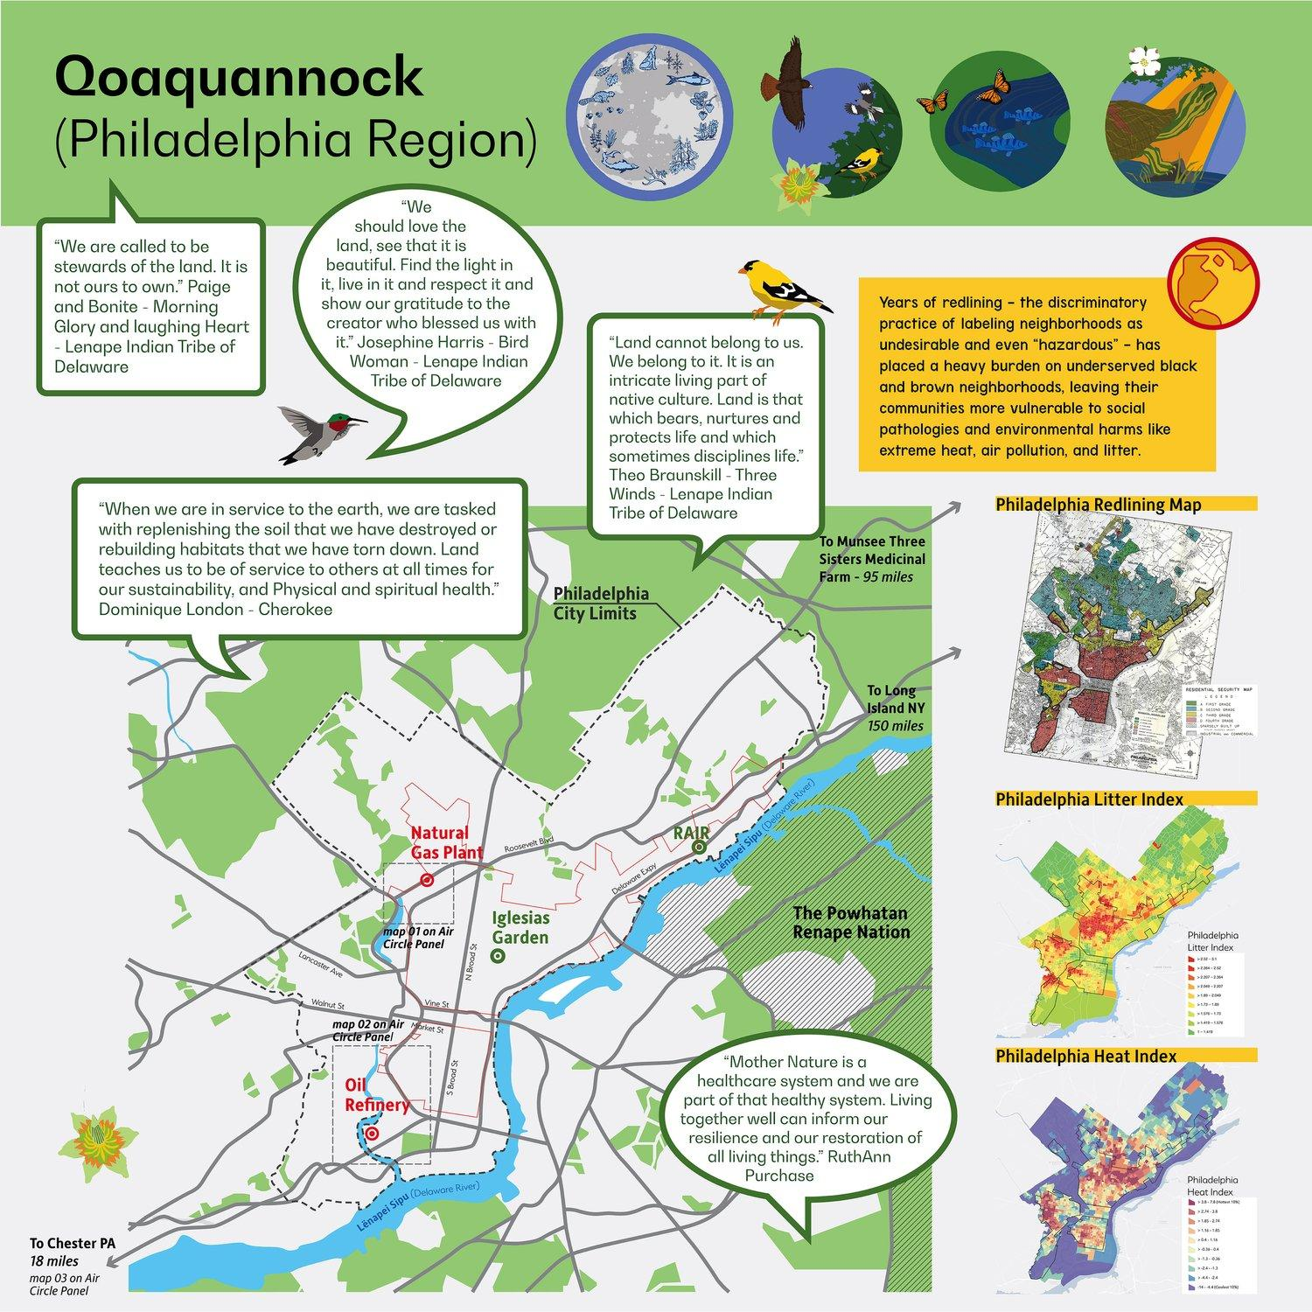
 |  |  |  |  |  |  | 38 | 40 | 42 | 45
SHARE
Main idea
Author’s purpose or point of view
One problem or issue
What are people and communities doing to help solve the problem?
3 key words or phrases
3 key pictures or images
What we still wonder

Slide 9

 |  |  |  |  |  |  |  | 40 | 42 | 45
SHARE
Main idea
Author’s purpose or point of view
One problem or issue
What are people and communities doing to help solve the problem?
3 key words or phrases
3 key pictures or images
What we still wonder

Slide 10
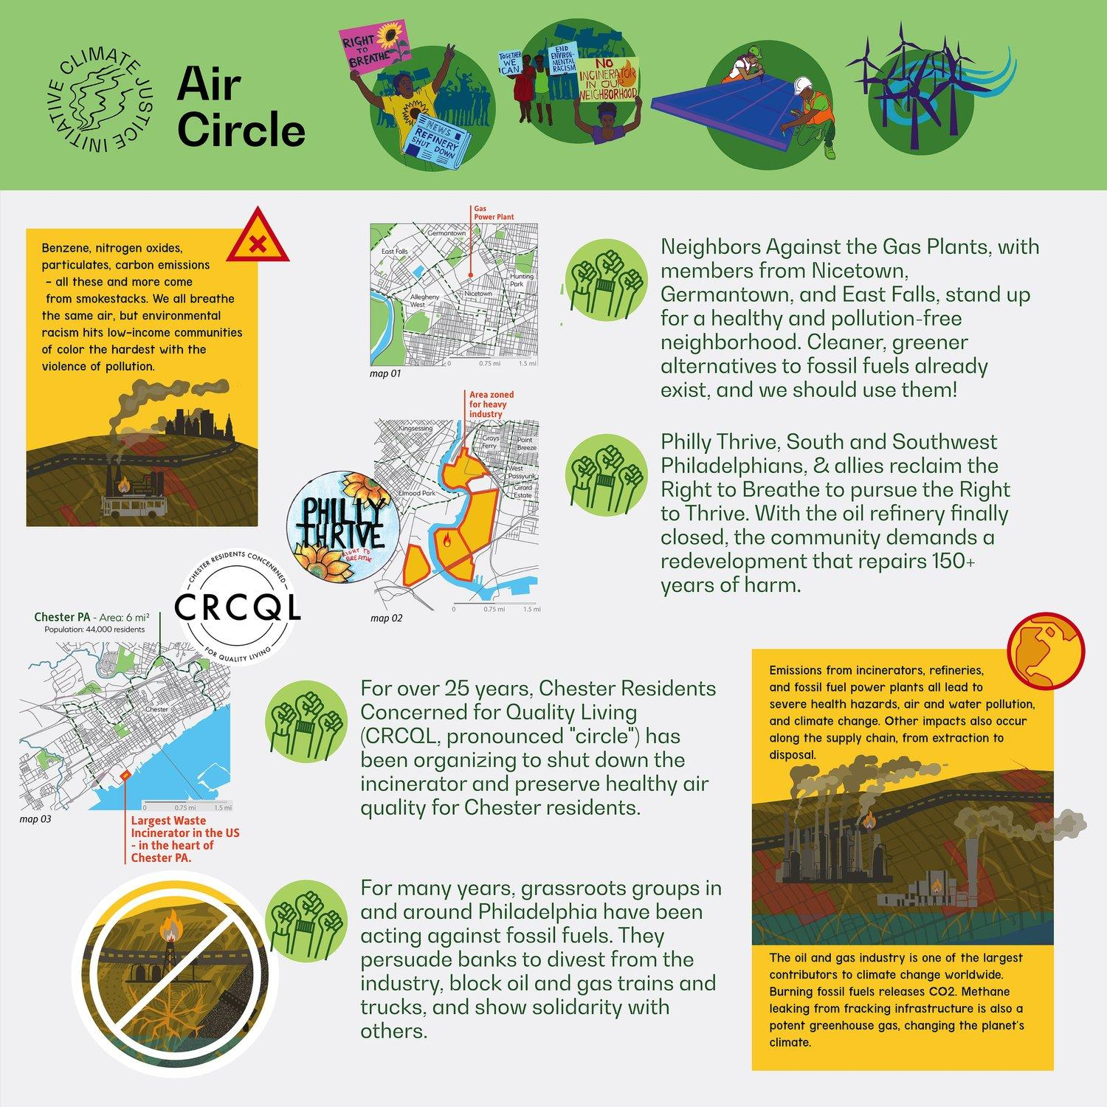
 |  |  |  |  |  |  |  |  | 42 | 45
SHARE
Main idea
Author’s purpose or point of view
One problem or issue
What are people and communities doing to help solve the problem?
3 key words or phrases
3 key pictures or images
What we still wonder

Slide 11

 |  |  |  |  |  |  |  |  |  | 45
SHARE
Main idea
Author’s purpose or point of view
One problem or issue
What are people and communities doing to help solve the problem?
3 key words or phrases
3 key pictures or images
What we still wonder

Slide 12


End of Lesson 3: Thank You!

