Slide 1
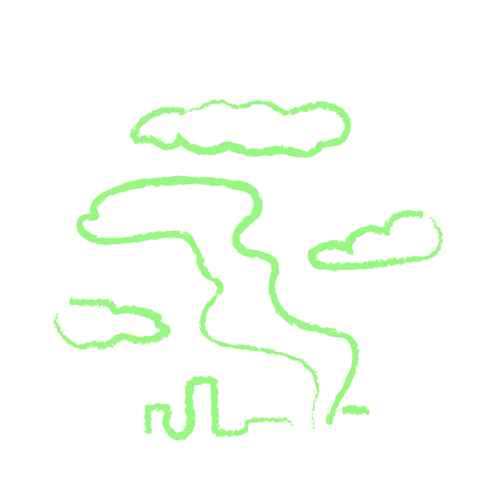
1 | 10
Lesson 3 - Part 1:
Our Environment, Our Home
Objective: Working in groups, students participate in an environmental scavenger hunt in the neighborhood surrounding their school, in order to draw connections between the imagery in the CJI mural and their own community.

Slide 2


 | 10
Key Terms
Environment: The air, water, soil, people, plants, animals, buildings, and culture that surround a person, place, or community.
Environment
Positive environmental impact: A human action that makes the environment better, healthier, safer, and more comfortable.
Positive environmental impact
Negative environmental impact: A human action that makes the environment worse, dirtier, or more dangerous.
Physical environment: Non-living things (rocks, soil, water, light, sound, buildings, and other human creations) in an environment.
Negative environmental impact
Physical environment
Biological environment: Living things (plants, animals, bacteria, fungi, and people) in an environment.
Biological environment

Slide 3

Neighborhood Environmental Scavenger Hunt!
 |  | 45
Clipboard
Camera
Pens
Stopwatch

Slide 4
 |  |  | 2
Lesson 3 - Part 2:
Our Environment, Our Home
Objective: In the second half of the lesson, students discuss their findings, including similarities and differences between their neighborhood and the CJI mural image. Then, each student group chooses a local environmental issue for their unit project.

Slide 5
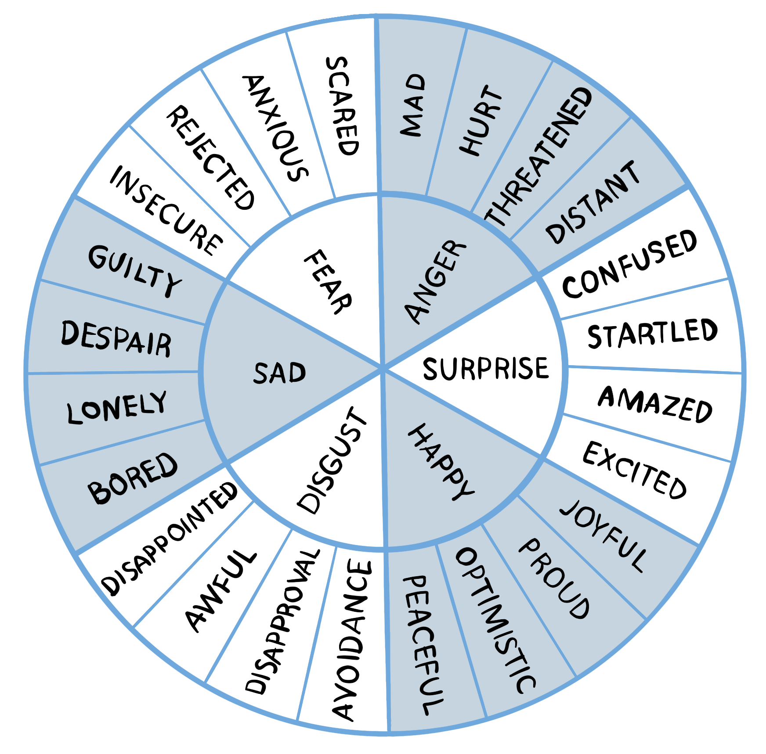
 |  |  |  | 7 | 12 | 17 | 22 | 30
Positive environmental impacts in our neighborhood:
What did you observe?
How did you feel when you observed this?

Slide 6
 |  |  |  |  | 12 | 17 | 22 | 30
Negative environmental impacts in our neighborhood:
What did you observe?
From feelingswheel.com/
How did you feel when you observed this?

Slide 7
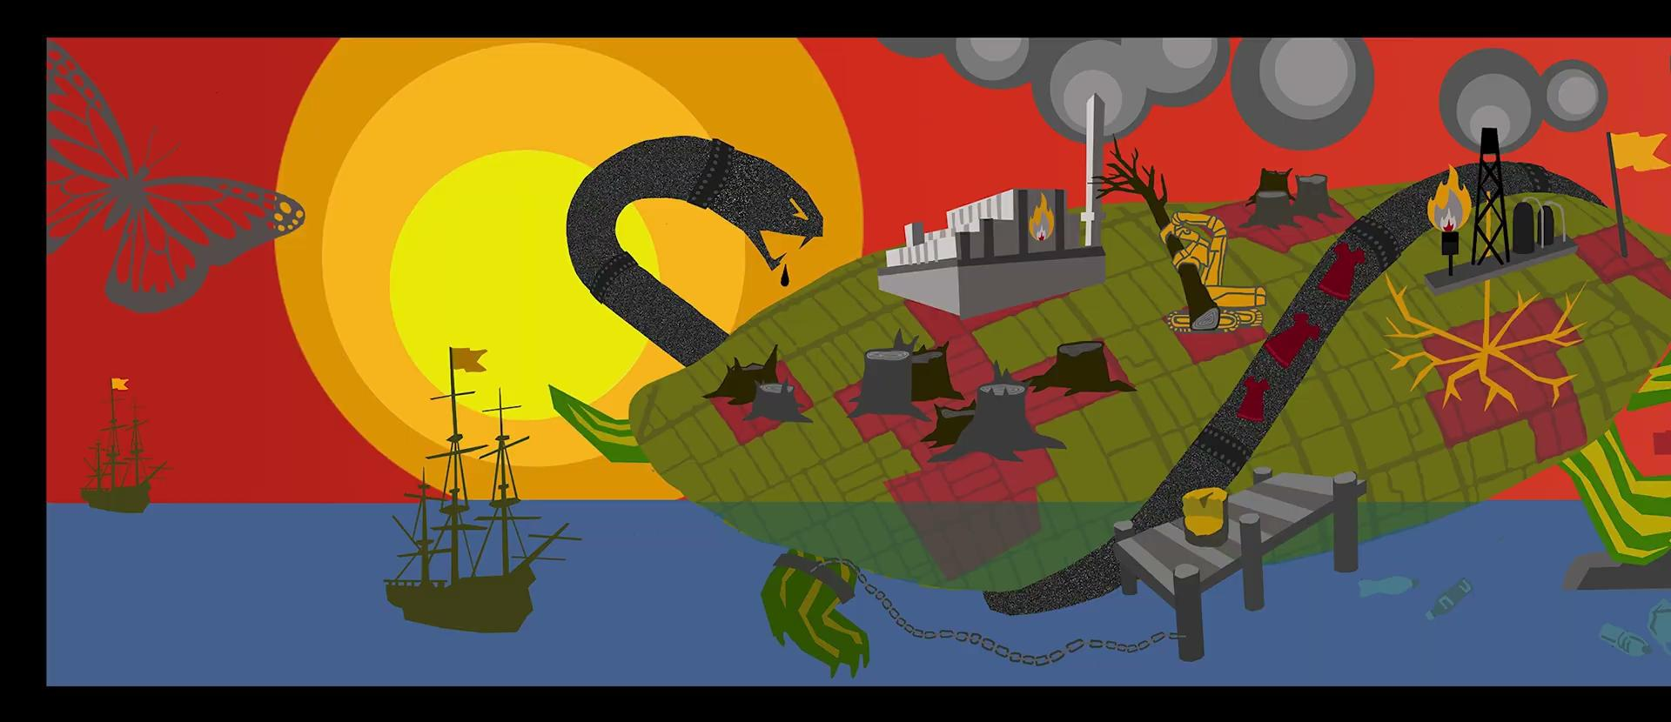
 |  |  |  |  |  | 17 | 22 | 30
Positive environmental impacts in the Climate Justice Mural:
What did you observe?
How did you feel when you observed this?

Slide 8
 |  |  |  |  |  |  | 22 | 30
Negative environmental impacts in the Climate Justice Mural:
What did you observe?
How did you feel when you observed this?

Slide 9
 |  |  |  |  |  |  |  | 30
SHARE
Similarities and Differences
What similarities do you notice between the mural image and your own observations in your neighborhood?
What differences do you notice?
Did you notice any other patterns or connections between positive and negative environmental impacts?

Slide 10

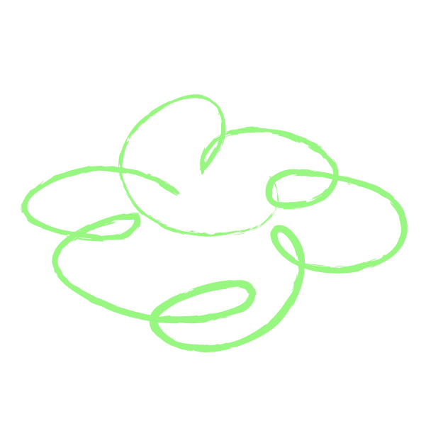

 |  |  |  |  |  |  |  |  | 38 | 45
Choose a local environmental problem (a negative environmental impact in your neighborhood) for your unit project!
Does everyone in your group agree with your topic of choice? Why or why not?
What are your reasons for choosing this topic? Do you have any doubts or concerns about this choice?
Do any of your group members have background knowledge of experience about this topic that could be helpful?

Slide 11
 |  |  |  |  |  |  |  |  |  | 45
SHARE
Your group’s choice with the class
Which local environmental problem did you choose to focus on?
Why did you choose to focus on this problem?
What do you know about this topic already?
(Time permitting) What questions do others have for you about this topic?

Slide 12


End of Lesson 3:
Thank You!

