Slide 1
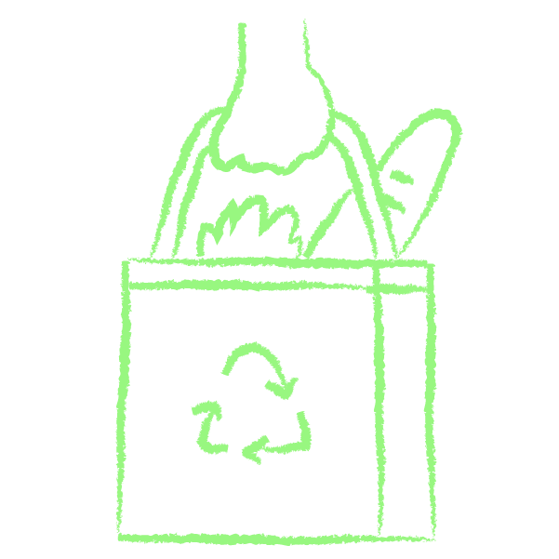
1 | 5 | 40 | 45
Lesson 5: Project Development
Objective: Students will plan and develop a creative product (such as a skit, poster, social media post, video, song/rap/spoken word, letter to the editor, etc.) that communicates to their peers about a local environmental problem, its root causes, a possible solution, and an action step.

Slide 2
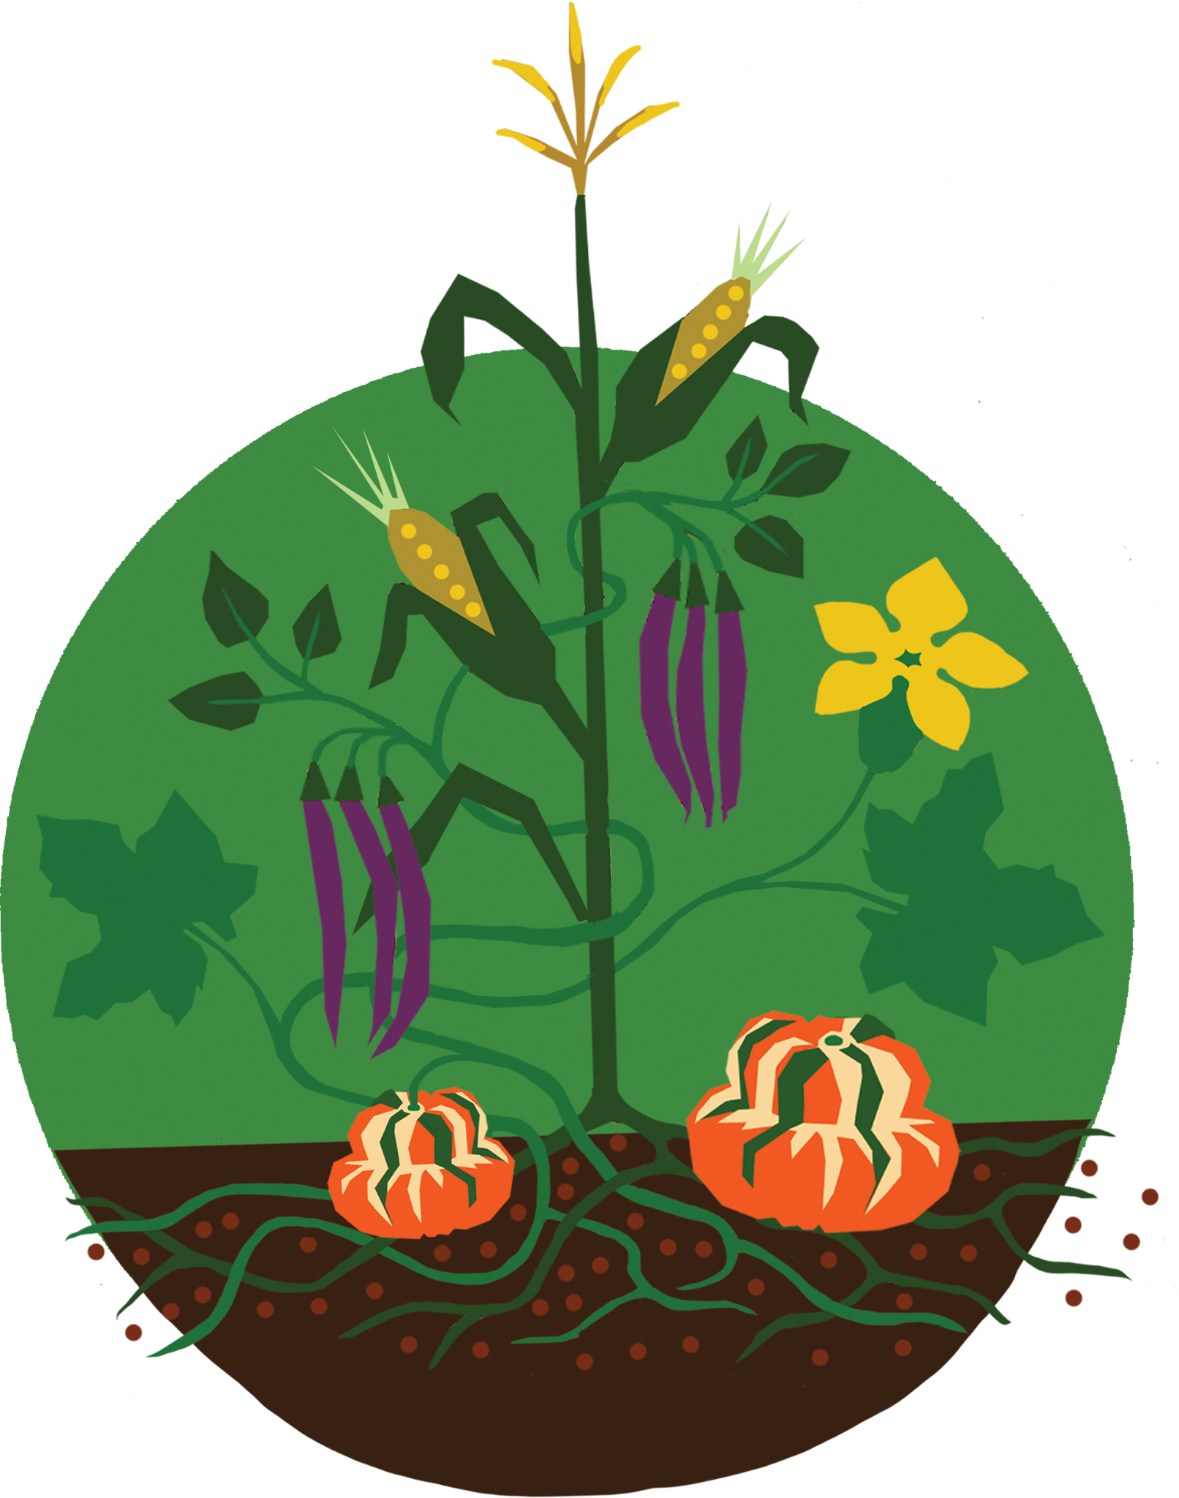
 | 5 | 40 | 45
Has your group completed these steps for a successful unit project?
If not, finish these first!
“Getting to the Roots” graphic organizer, side 1: The Five Why’s
“Getting to the Roots” graphic organizer, side 2: Research
Unit Project Rubric to evaluate two examples
Do you have any questions about how your group can work together well to create a successful project?

Slide 3

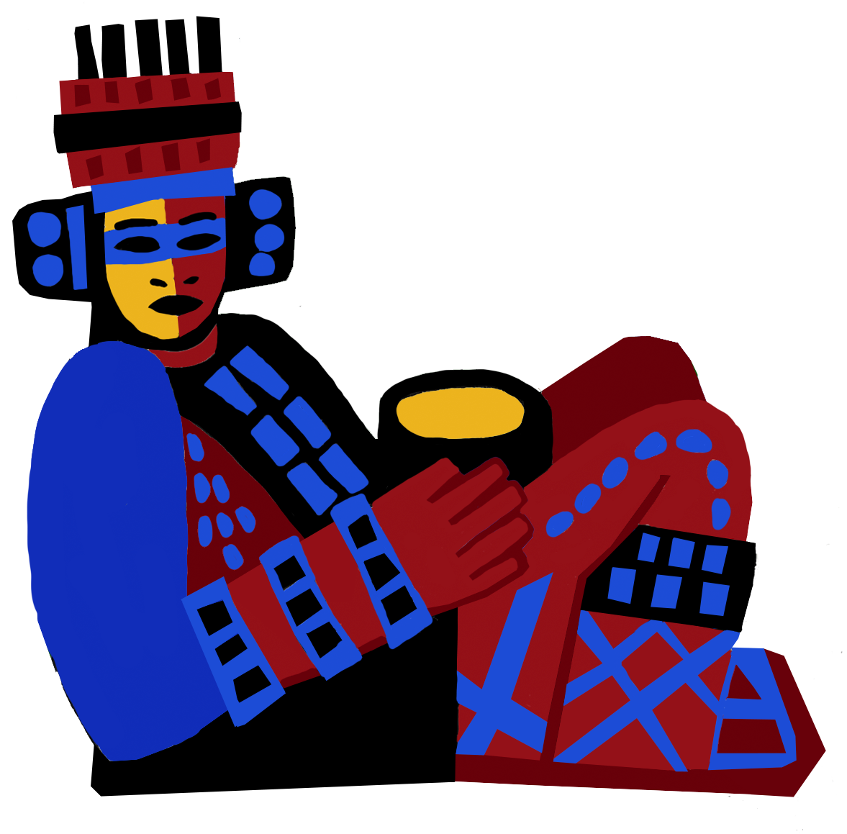
 |  | 40 | 45
Group work time!
If you get stuck, ask each other:
“Do we need to learn more about our problem, including its causes and solutions?” (If so, you need to do more research! Ask your teacher if you need help finding reliable sources.)
“Have we included each of the following in our project?”
Name of the problem
Symptoms of the problem
Root cause(s) of the problem
Possible solution(s)
Action step(s)
Appropriate vocabulary
Appropriate images
At least one statistic
Citations
“What score would this project get on the Unit Project Rubric? And how could we improve that score?”

Slide 4

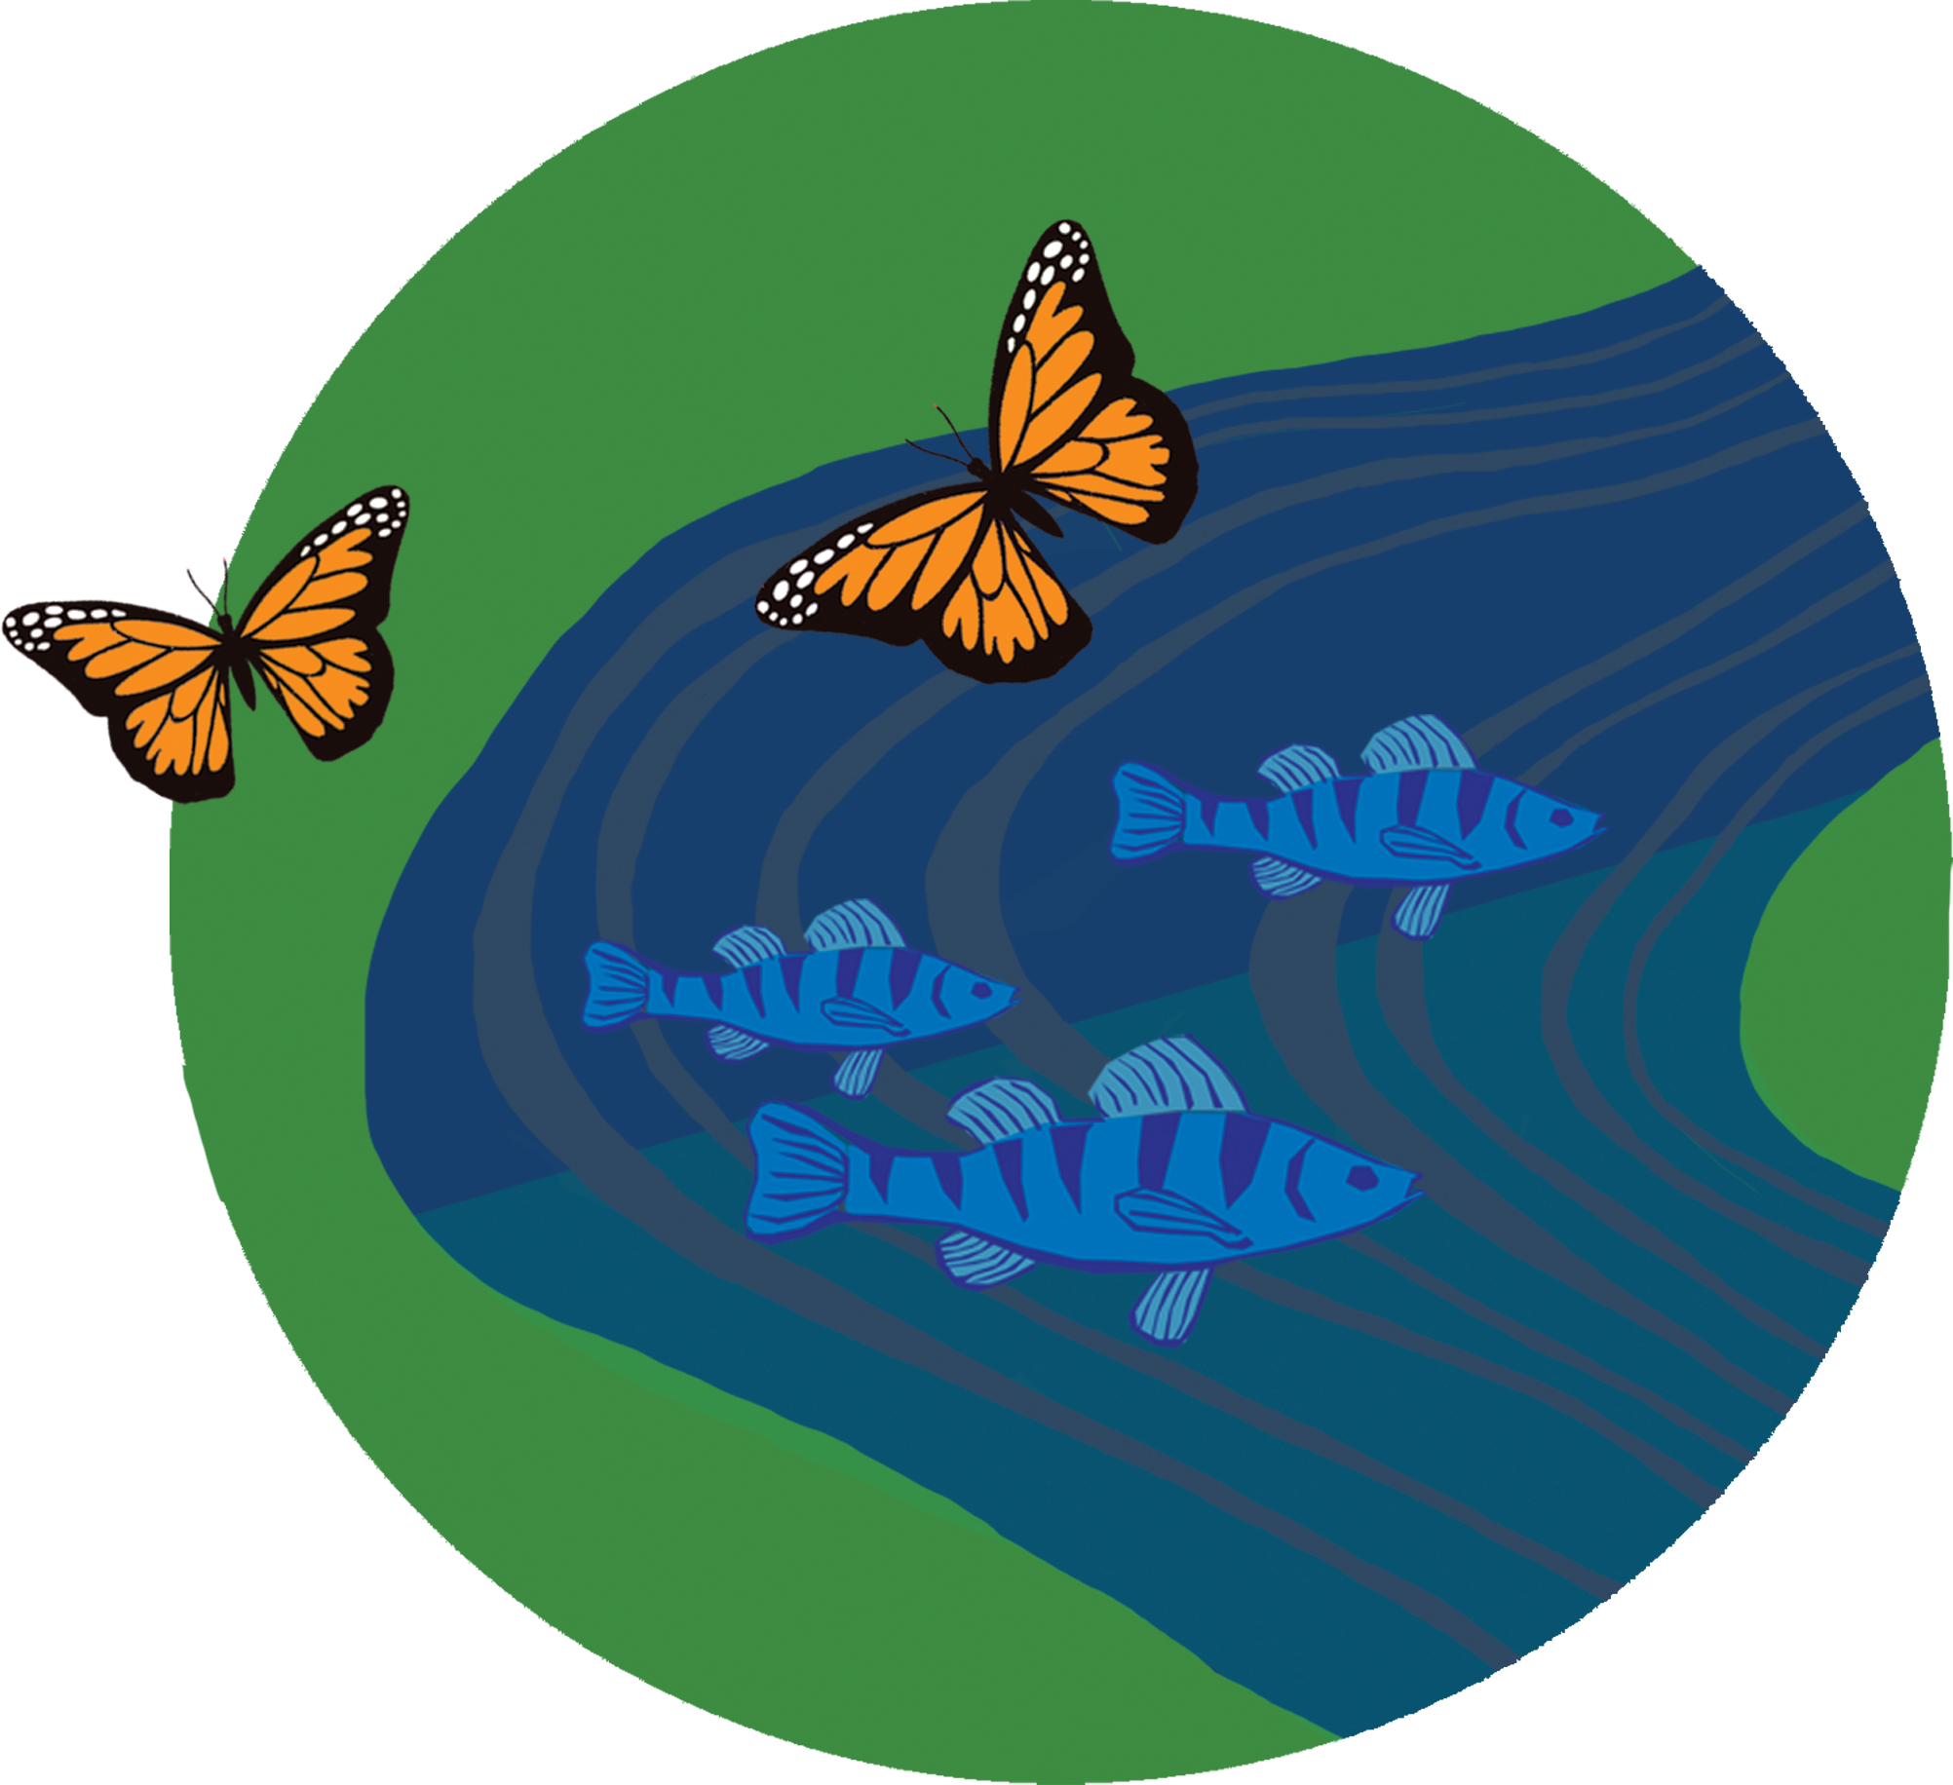
 |  |  | 45
Share your group’s progress
What did you work on today?
What do you need to do next?
What questions do you have?

Slide 5


End of Lesson 5: Thank You!

