Slide 1

1 | 40 | 45
Lesson 6: Project Feedback
Objective: Students share their creative product with the class, and
provide feedback to their classmates. They make a plan to improve their products in order to share with the broader community.

Slide 2
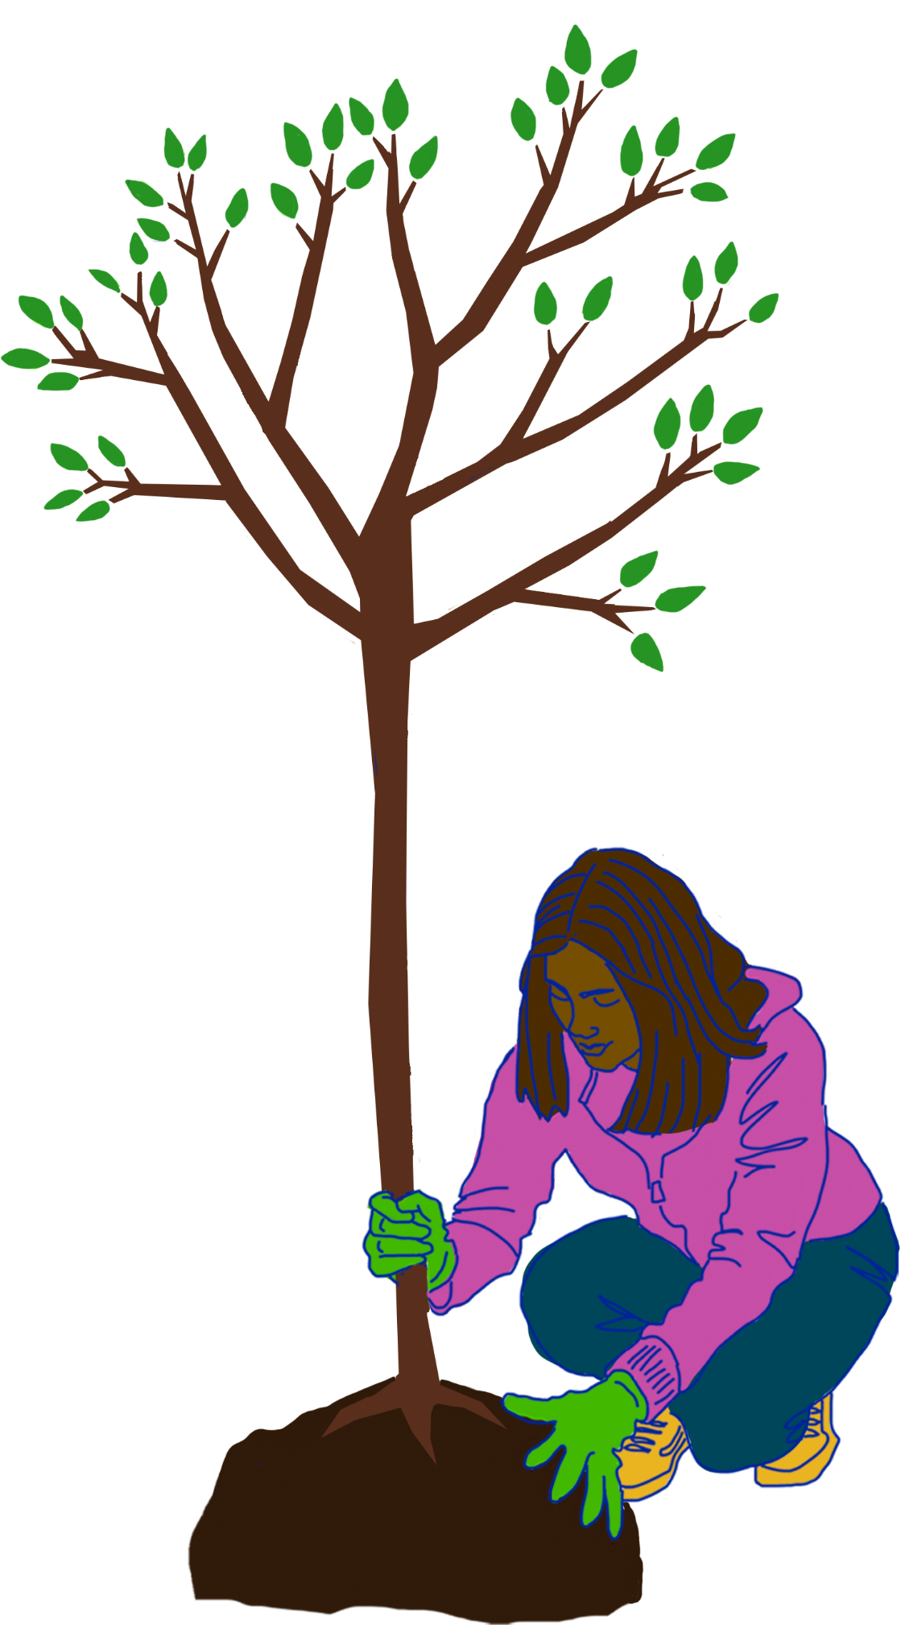
 | 40 | 45
While you are watching your classmate’s presentations
Evaluate their projects using your Unit Project Rubric
After they are done:
Share your “glows” (What did the group do really well?)
Share your “grows” (How could this project be even better?)
Raise your hand to ask a relevant question about their project
Time limit for each group: ____ minutes, including time for questions

Slide 3
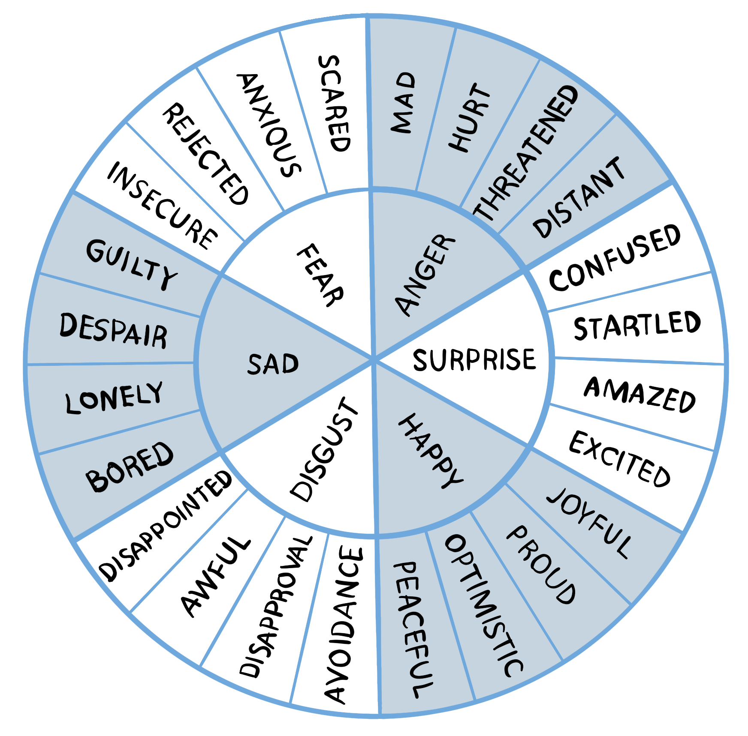
 |  | 45
Discuss with your group
How are you feeling about your project?
How would you define climate justice to someone who doesn’t know what it is?
How can you share what you learned with the wider community?

Slide 4


End of Lesson 6: Thank You!

